Slide 1


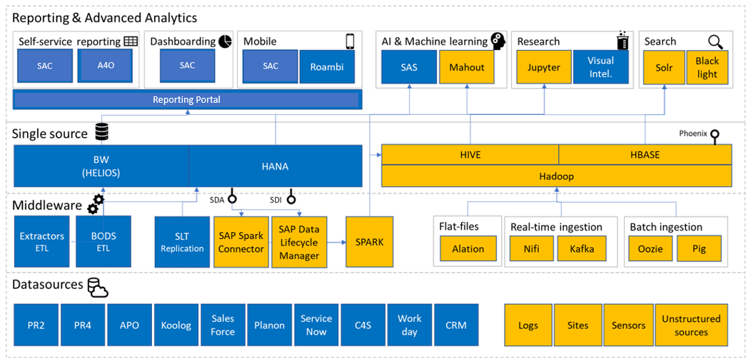
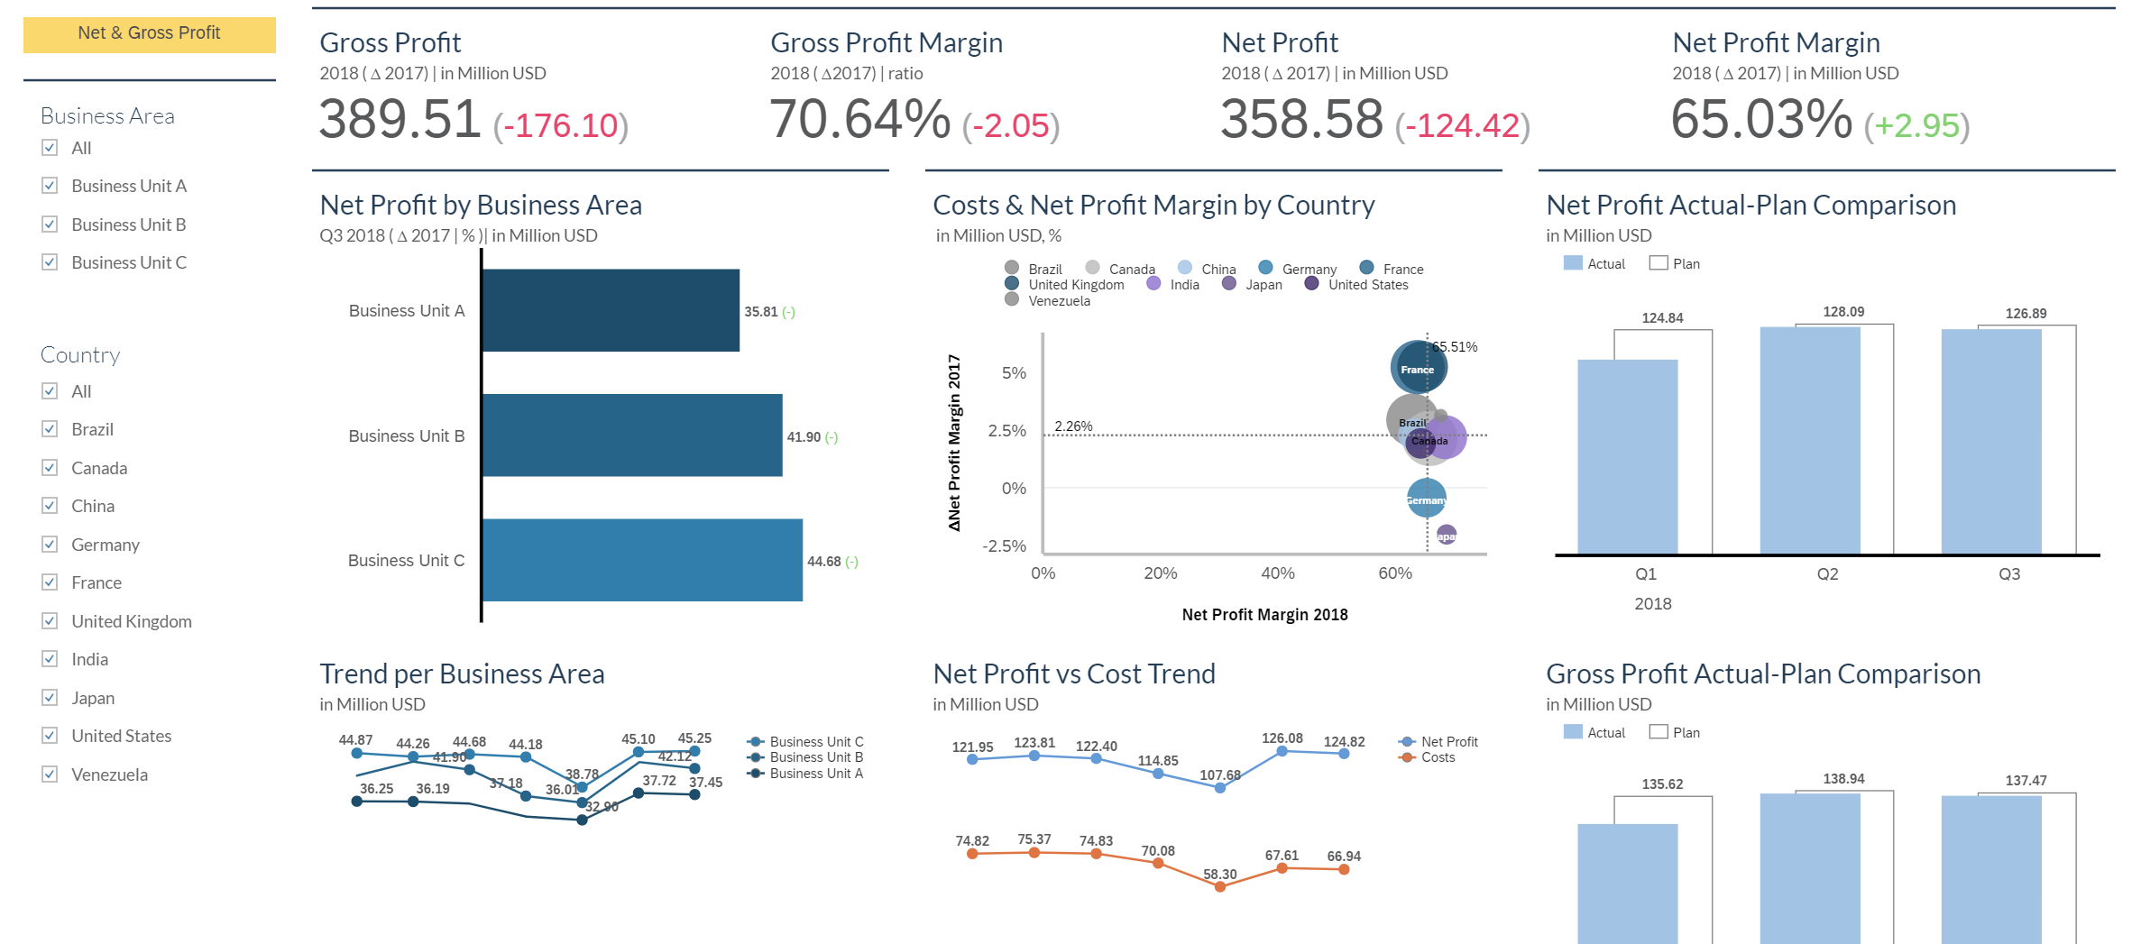

Financial Services
CASE STUDY
Challenges
Initial Analysis done on the BW and BPC systems to understand and come up with recommendations
Identified a lot of regular system up keep tasks were not being performed.
Identified Objects and storage structures that could be optimized and certain process chains run for automation in BW
Lumira Dashboards Required redesigning,out put optimization and improvement in performance
Solution
Stabilized the BW system by cleaning log entries and there by reduction in space
Which led to the faster data retrieval
Optimized Certain BW objects and hence bettered load times .
Designed and developed reports in the Tax and Vendor payment areas..
Redesigned the Lumira Dashboard and improved the execution and load times and increased the performance by more than 50%
Enhanced user experience by adding new components and enabled easier navigation of dashboards.
70%
85%
Financial Services
One of India's most diversified non-banking finance company. It is focused on lending, asset management, wealth management and insurance.
Technology
SAP BW, SAP BPC ,SAP Analysis for Office..
Performance of Reports
Integration
Live Reporting
Standard Reporting

