Slide 1
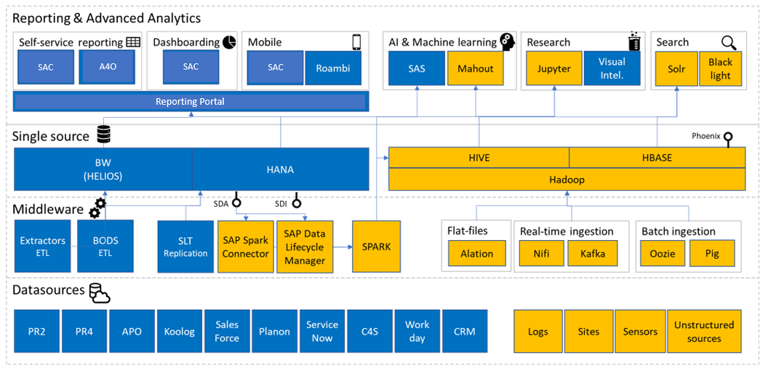
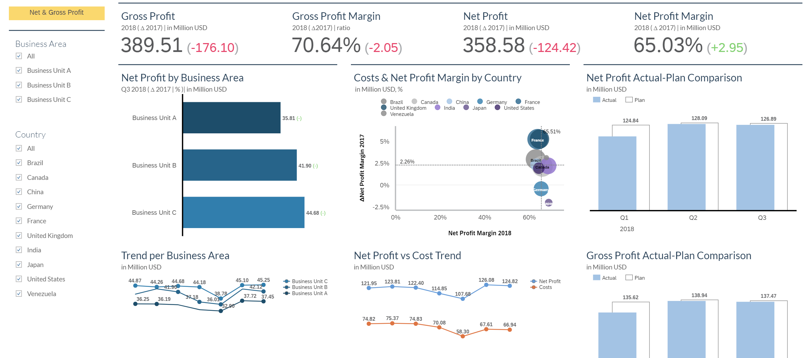
Global Sales Reporting
CASE STUDY
Challenges
Subscribed for SAP Analytics Cloud tool but need support on building stories and other analytics with the data on HANA using Live connection.
Technical difficulties faced for achieving the requirement of users as SAC is upcoming tool.
End Users need to be educated on the usage of the tool and accessing the reports.
Need support in maintaining the reports in the SAP Analytics Hub.
Solution
Streamlined the data integration with the source system.
Developing the SAC reports for the Finance Staff which are used by the users across the globe (Europe, Latam, etc.,)
Proposed solutions met the requirements of users with the workarounds.
Successfully migrated and consolidated 300+ Finance reports into 15 reports in SAC.
Developed and harmonized the stories for easy accessibility and accuracy of reports
70%
85%
Lighting Giant
A world leader in lighting for professionals, consumers and lighting for the Internet of Things. With and Annual turnover of over 6 Billion and presence in over 70 countries.
Technology
SAP BW, SAP HANA, SAP BODS, SAP Analytics Cloud.
Performance of Reports
Integration
Live Reporting
Standard Reporting

