Slide 1
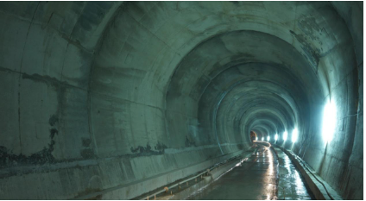

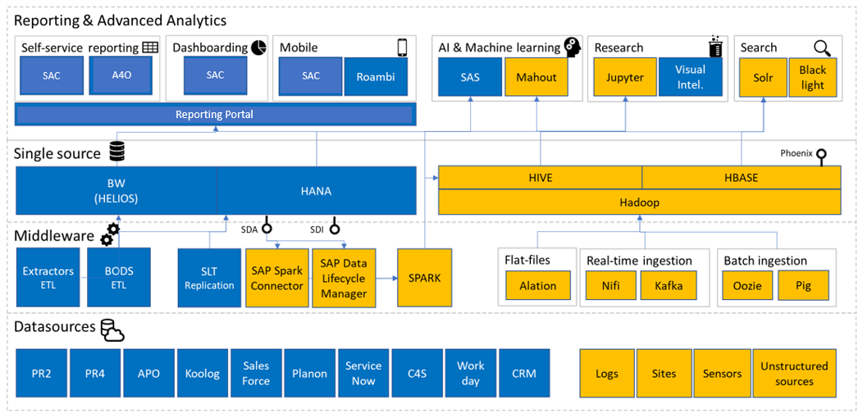
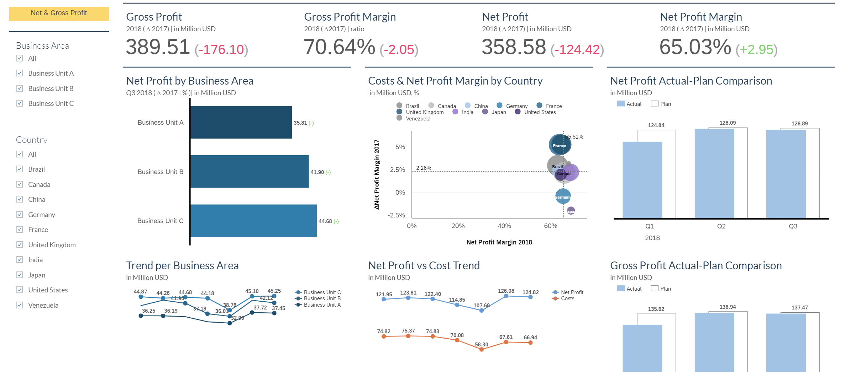

Infrastructure
CASE STUDY
Challenges
Subscribed for SAP Analytics Cloud tool but need support on the configuration of the Certificate and the CORS ( Cross Origin Resource sharing) configuration..
Dashboard requirements were in the areas of Inventory ,HR, Project Systems, Accounts Payable – Ageing, Accounts Receivable Ageing and Tax.
Reports pertaining data for dashboards was taking time to execute.
Roles & Authorizations needed to be defined.
End Users need to be educated on the usage of the tool and accessing the reports.
Data discrepancies existed and needed to be corrected .
Solution
CORS configuration was setup and the SSL (Secured software layer) certificates configured
Dashbords developed for the Inventory ,HR, Project Systems, Accounts Payable – Ageing, Accounts Receivable Ageing and Tax .
Validations were done for each of the dashboard.
Customized CDS views were developed to cater to the requirements.
Multiple pages were developed to show different levels of details
Enabled filters on most of the dimensions and measures.
70%
85%
Infrastructure Major
An Infrastructure Major in India and most highly reputed providers of Civil engineering , Infrastructure and mining services offering specialization expertise across four major segments Roads, Highways & Tunnels, Irrigation & Mining.
Technology
SAP BW, SAP BPC ,SAP Analysis for Office..
Performance of Reports
Integration
Live Reporting
Standard Reporting

